Slide 1
Student App Screenshots
Done by me!

Slide 2
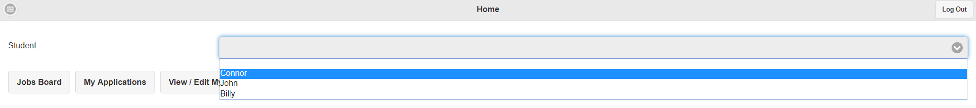
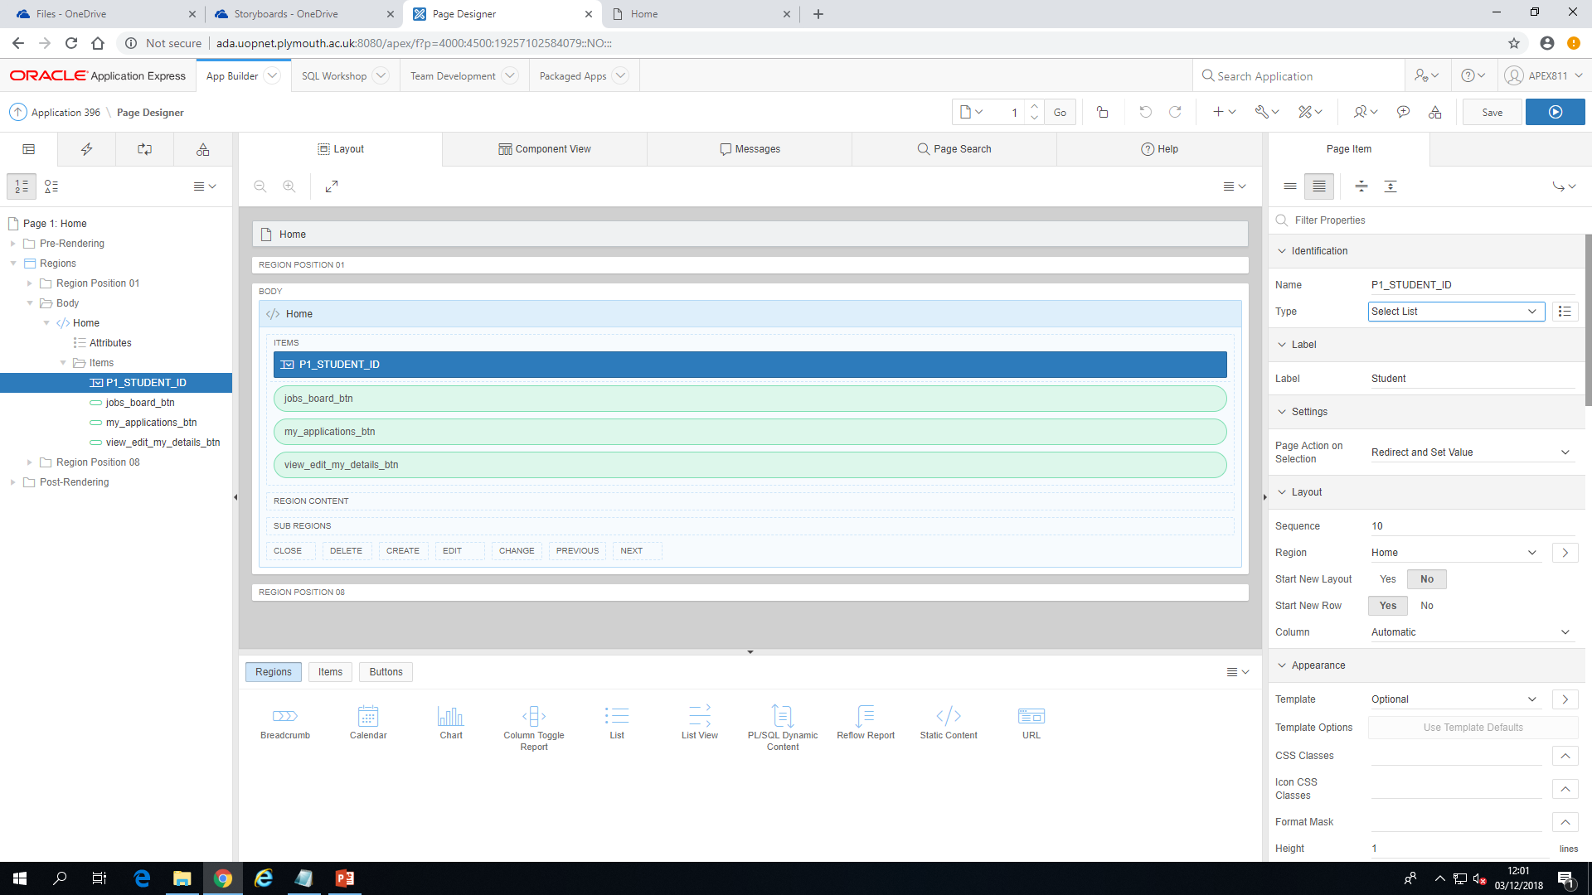
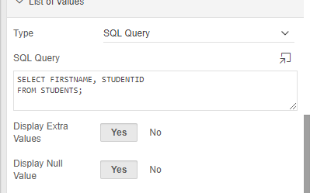
Home
Notes:
‘Home’ displays navigation buttons to take the user to other pages, which includes ‘Jobs Boards’, ‘My Applications’ and ‘View/Edit My Details’. Also contains a Select List that displays all the students’ names within the drop-down menu.

Slide 3
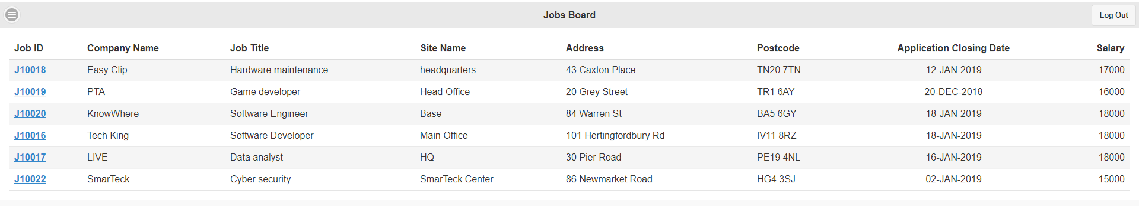
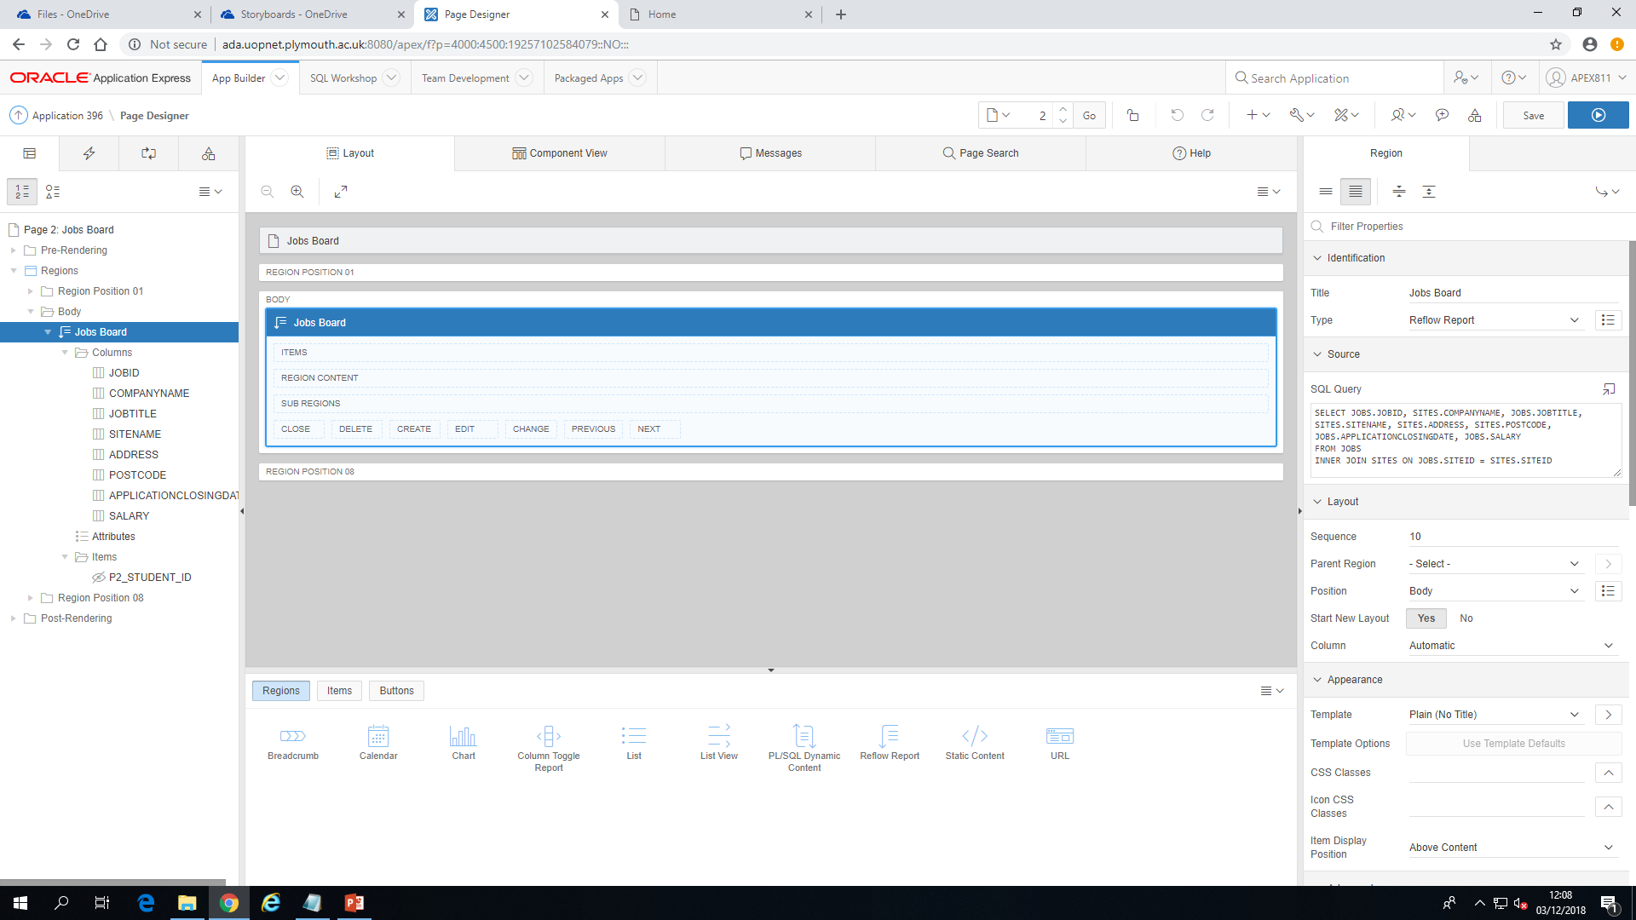
Jobs Board
Notes:
‘Jobs Board’ contains a reflow report which uses a SQL query to display all relevant information of a job in a table. The user can click on the ‘Job ID’ to be taken to a separate page showing all information specific to the job. Useful for information that does not fit into the table, such as the job description.

Slide 4
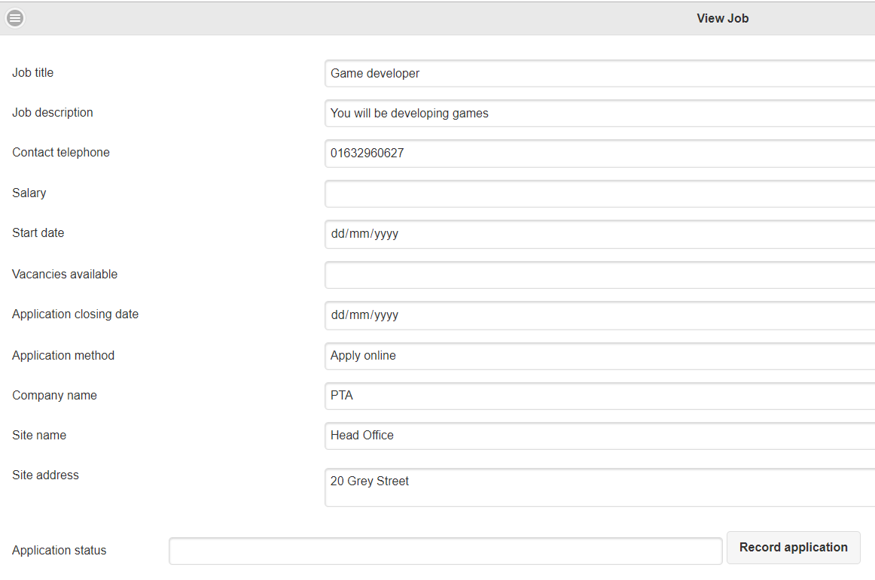
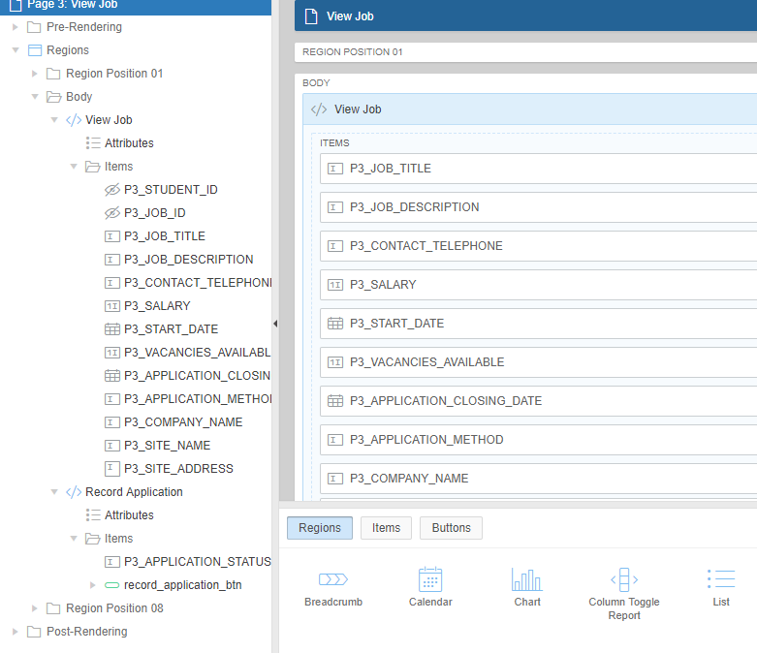
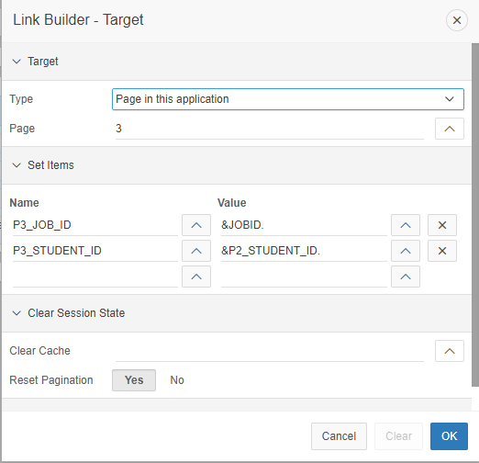
View Job
Notes:
‘View Job’ contains Static Content with columns relevant to the Job’s details. In order to transfer the information across from ‘Jobs Board’ to ‘View Job’, the settings of the column had to be ‘Link’, which will navigate the user to the ‘View Job’ page. The text fields must be automatically filled with the appropriate information when this happens, and therefore we were required to use the ‘Set Name’ property.

Slide 5
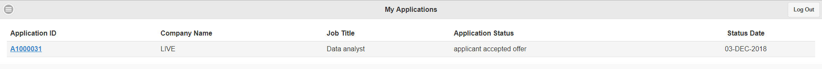
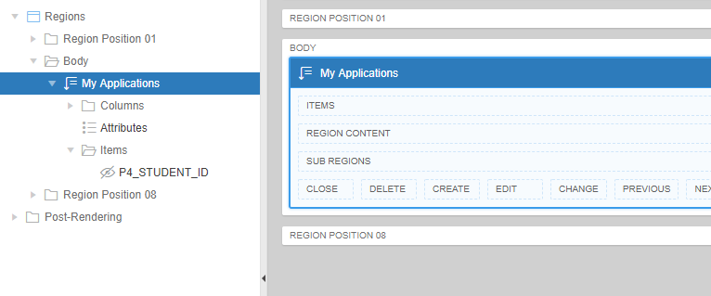

My Applications
Notes:
‘My Applications’ is very similar to the ‘Jobs Board’ page, in which it contains a reflow report which extracts specific information from the database and structures it in a table. The relevant headings are ‘Application ID’, ‘Company Name’, ‘Job Title’, ‘Application Status’ and ‘Status Date’.

Slide 6
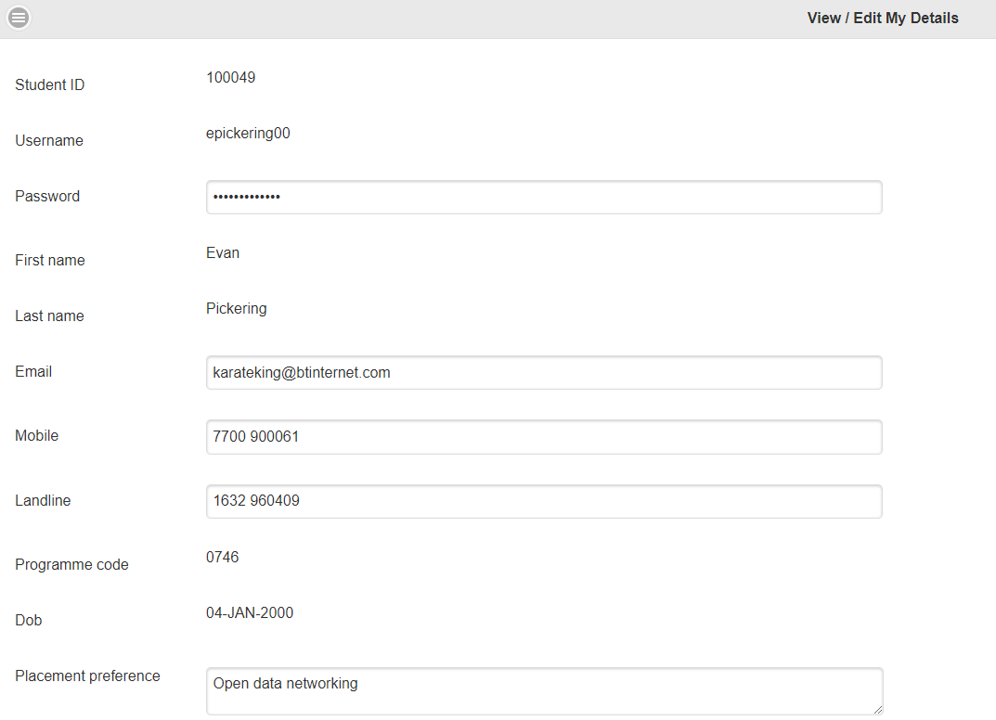
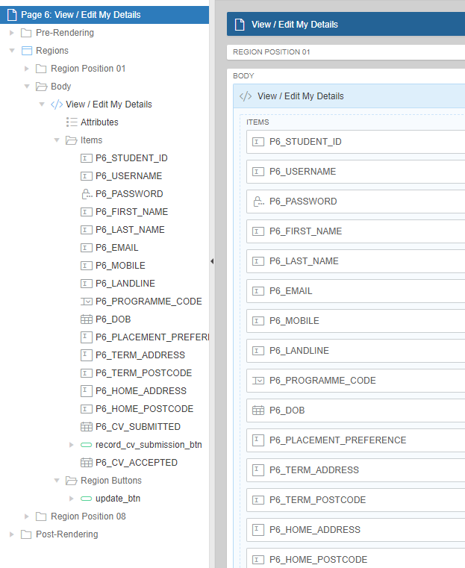
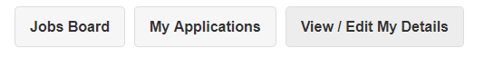

View/Edit My details
Notes:
‘View/Edit My Details’ displays the user’s details; this is done by using similar methods for ‘View Job’ page.

